Slide 1
MANET ROUTING OPTIMISATION
DSDV Routing Optimisation Using Grey Wolf Optimisation
Enhancing dynamic MANET performance through metaheuristic parameter tuning
Team: Soham Patil 2023IMT-080 · Abhinav Arya 2023IMT-002 · Manshu Jaiswal 2023IMT-051 · Ayush Gautam 2023IMT-022
Notes:
Good morning. Today we present our research on optimizing Destination-Sequenced Distance-Vector (DSDV) routing in Mobile Ad-Hoc Networks using Grey Wolf Optimisation. I will introduce the mobility problem and our tuning architecture, followed by my colleagues who will explain the protocol mechanics, algorithm, and simulation results.

Slide 2
01 · PROBLEM FORMULATION
Static DSDV timers break when nodes move fast
Default protocol parameters fail across mobile ad-hoc topologies under high node velocity.
FAILURE MODE A
FAILURE MODE B
Stale Routes & Drops
Overhead & Congestion
At speeds of 5–20 m/s, link topology changes before the 15 s periodic update broadcasts. Packets hit broken links, causing severe packet loss and dropped flows.
Overly aggressive broadcast frequencies flood wireless bandwidth with routing tables, queueing data frames and triggering radio contention collapses.
Periodic Update
Settling Time
Queue Length
Queue Hold Time
15 s default
6 s default
64 packets
30 s default
Research Question: Can GWO systematically discover the optimal multi-parameter balance that maximizes PDR without triggering control overhead collapse?
Notes:
Standard DSDV uses fixed default timers established for low-mobility setups: 15-second update intervals, 6-second settling delays, 64-packet queues, and 30-second queue times. When mobile nodes travel at 5 to 20 meters per second, these defaults create an impossible tension: slow updates lead to stale routes and packet loss, while fast updates saturate the wireless channel with table broadcasts. Our goal is automating this trade-off.

Slide 3
02 · ARCHITECTURE
A closed loop lets GWO tune DSDV against the simulator
Protocol core stays untouched, so loop-freedom is preserved.
01
02
03
04
Candidate Vector
Simulation Run
Metric Extraction
Fitness Feedback
Wolf proposes a 4D vector: update interval, settling time, queue length, queue time.
Simulator runs DSDV with that vector.
PDR, delay and overhead are measured.
Fitness score returns to the pack.
Protocol Core
Fewer Hyperparameters
Protocol core stays untouched, so loop-freedom is preserved.
GWO has fewer hyperparameters than GA or PSO.
Notes:
Here is our closed-loop architecture. In each iteration, each wolf in the pack proposes a candidate 4D parameter vector. The simulator executes a dynamic MANET mobility trial, records packet metrics, and computes a composite fitness score. Because we tune only the timer and buffer parameters rather than the routing logic itself, DSDV's sequence-number loop-freedom property is strictly preserved.

Slide 4







03 · DSDV PROTOCOL RULES
DSDV accepts routes by sequence number, then hop count
Strict destination sequence numbering prevents Bellman-Ford count-to-infinity and routing loops.
ROUTING TABLE ENTRY FORMAT
[ Destination Address | Next Hop | Metric m | Sequence Number S | Install Time ]
RULE 1
RULE 2
RULE 3
Route Acceptance
Settling Delay Filter
Link Breakage Signal
Accept update if . If , accept only if . Newer destination updates always supersede older routes.
Route advertisements are deferred until to suppress premature broadcasts of fluctuating secondary paths.
On physical link loss, metric becomes and destination sequence number increments to an odd integer .
Notes:
I am Abhinav, and I will explain how DSDV processes route updates. Every routing entry maintains destination, next-hop, metric m, sequence number S, and installation time. An advertisement is accepted if its sequence number is strictly greater, or if equal, has a lower hop count. Settling delay prevents advertising suboptimal routes prematurely, while link breaks are advertised immediately with an infinite metric and an odd sequence number.

Slide 5
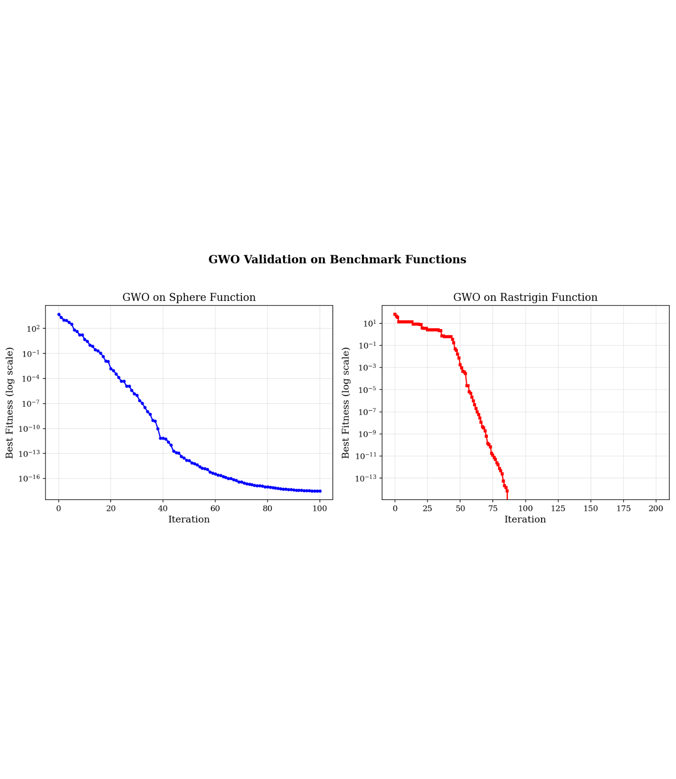


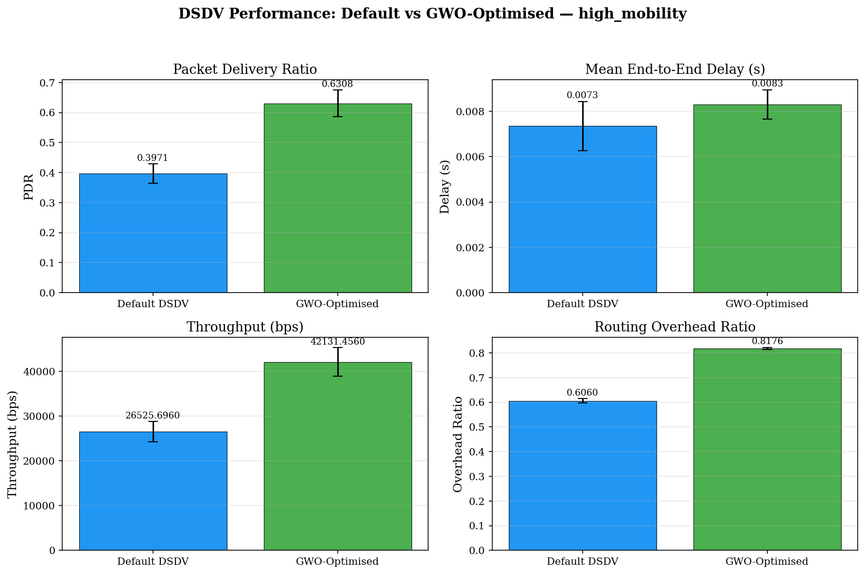





BENCHMARK VALIDATION
04 · OPTIMISATION ENGINE
GWO closes in on the best solution through three leaders
The pack mimics grey wolf social hunting hierarchy: represent the best three solutions, guiding the remaining wolves .
Alpha (α)
Beta (β)
Delta (δ)
Best Fit
Second
Third
Parameter decays linearly from 2 to 0 across iterations: enforces global exploration, while forces local exploitation around the pack leaders.
Synthetic validation: Sphere achieves ; multimodal Rastrigin achieves exact global minimum .
Notes:
Grey Wolf Optimisation uses a leadership hierarchy where alpha, beta, and delta encircle prey. Vectors A and C control balance: parameter a decreases from 2 to 0, ensuring broad exploration when absolute A exceeds 1, and fine exploitation when absolute A is under 1. Before applying GWO to MANET, we validated the algorithm on Sphere and Rastrigin functions, achieving near-perfect convergence to machine precision.

Slide 6



05 · FITNESS FORMULATION
Simulator blocks feed a weighted fitness score
Event Queue
Mobility
Links
Traffic
Random Waypoint
Unit-disk
CBR UDP
FITNESS OBJECTIVE FUNCTION
DISCONNECTION PENALTY
+10
Failed or disconnected runs score +10 penalty.
Notes:
I am Manshu. Our discrete-event simulation engine steps at 0.1-second resolution using Random Waypoint mobility, unit-disk links with 250-meter radio range, and constant bit-rate UDP traffic. The fitness function balances delivery ratio, delay, and overhead. Delivery loss receives highest priority with a 0.5 weight. If an unstable parameter vector disconnects the network or drops all packets, a harsh plus-10 penalty eliminates that candidate.

Slide 7
06 · EXPERIMENTAL SETUP
Three scenarios test a four-parameter search space
Optimiser pack of 10 wolves evaluated across 15 iterations per scenario.
4D PARAMETER BOUNDS
TEST SCENARIO DEFINITIONS
Parameter | Search Range | Default
Update Interval | 5.0 – 30.0 s | 15.0 s
Settling Time | 1.0 – 15.0 s | 6.0 s
Queue Length | 16 – 256 pkts | 64 pkts
Queue Time | 5.0 – 120.0 s | 30.0 s
Scenario | Nodes & Flows | Mobility Speed | Trials & Time
Small | 15 nodes, 4 flows | 1 – 10 m/s | 3 seeds, 60 s
Medium | 20 nodes, 5 flows | 1 – 10 m/s | 5 seeds, 100 s
High Mobility | 20 nodes, 5 flows | 5 – 20 m/s | 5 seeds, 100 s
Optimization parameters: 10 grey wolves, 15 search iterations. Multi-seed simulation ensures statistical validation across stochastic mobility runs.
Notes:
To rigorously test GWO, we bounded the 4D parameter space around standard operating values and defined three increasingly challenging scenarios: Small with 15 nodes, Medium with 20 nodes, and High Mobility where node velocities reach 20 meters per second. Ten grey wolves iteratively explored these bounds across multiple random seeds to avoid overfitting to a single mobility trace.

Slide 8
07 · RESULTS & ANALYSIS
GWO lifts delivery ratio 30–59%, at the cost of overhead
Scenario | Default PDR | GWO PDR | Stat. Significance | Throughput (kbps) | Overhead
Small | 64.7% | 84.0% | +29.7% (p=0.0379) | 34.8 → 45.2 | 0.49 → 0.74
Medium | 61.5% | 80.0% | +30.1% (p=0.0064) | 40.8 → 53.1 | 0.60 → 0.80
High mobility | 39.7% | 63.1% | +58.9% (p=0.000025) | 26.5 → 42.1 | 0.61 → 0.82
LEARNED POLICY
Update interval 15 s to about 5.5 s; settling time 6 s to 2.5–3.9 s; queue 64 to 106–113.
TRADE-OFF
Overhead 0.60 → 0.80
Delay stays under 9 ms and is not significant.
Notes:
I am Ayush Gautam, concluding our findings. GWO converged on an intuitive policy: broadcast updates roughly three times more frequently around 5.5 seconds, halve the settling delay, and expand queue capacity to ~110 packets. Across all scenarios, packet delivery ratio jumped by 30% to nearly 60%, with p-values proving high statistical significance. Overhead rose moderately from 0.60 to 0.80, while end-to-end latency remained below 9 milliseconds. Thank you, and we welcome your questions.

Slide 9
Thank you
Notes:
Thank you for listening. Our team: Soham Patil, Abhinav Arya, Manshu Jaiswal, and Ayush Gautam. We welcome your questions.

